Slide 1
Introduction to Convolution Neural Networks (CNN) and systems
KH Wong

Slide 2
Overview
Part A
A1. Theory of CNN
A2. Feed forward details
A3. Back propagation details
Part B: CNN Systems

Slide 3
Introduction
Very Popular:
Toolboxes: tensorflow, cuda-convnet and caffe (user friendlier)
A high performance Classifier (multi-class)
Successful in object recognition, handwritten optical character OCR recognition, image noise removal etc.
Easy to implementation
Slow in learning
Fast in classification

Slide 4
Overview of this note
Prerequisite: knowledge of Fully connected Back Propagation Neural Networks (BPNN), in the last lecture
Convolution neural networks (CNN)
Part A2: feed forward of CNN
Part A3: feed backward of CNN

Slide 5
Part A.1 Theory of CNN
Convolution Neural Networks

Slide 6
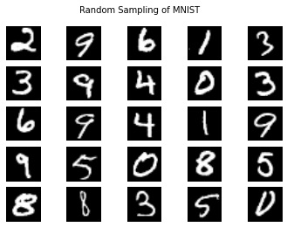
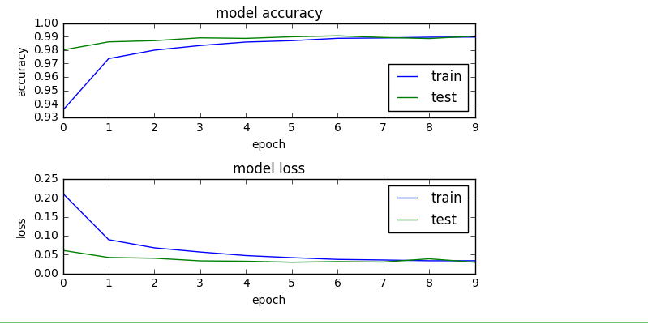
An example optical character recognition (OCR)
Example test_example_CNN.m in http://www.mathworks.com/matlabcentral/fileexchange/38310-deep-learning-toolbox
Based on a data base (mnist_uint8, from http://yann.lecun.com/exdb/mnist/)
60,000 training examples (e.g. 28x28 pixels each)
10,000 testing samples (a different dataset)
After training , given an unknown image, it will tell whether it is 0, or 1 ,..,9 etc.
https://towardsdatascience.com/a-simple-2d-cnn-for-mnist-digit-recognition-a998dbc1e79a

Slide 7

The basic idea of Convolution Neural Networks CNN Same idea as Back-propagation-neural networks (BPNN) but different implementation
After vectorized (vec), the 2D arranged inputs become 1D vectors. Then the network is just like a BPNN
(Back propagation neural networks )
https://adeshpande3.github.io/adeshpande3.github.io/A-Beginner%27s-Guide-To-Understanding-Convolutional-Neural-Networks/

Slide 8
Basic structure of CNN
The convolution layer: see how to use convolution for feature identifier

Slide 9
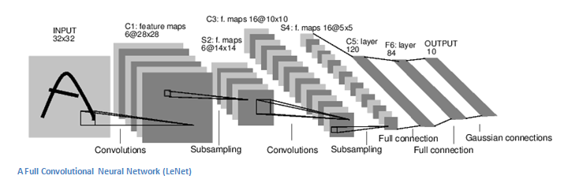
The basic structure
Input conv. subs. conv subs fully fully output
Alternating Convolution (conv) and subsampling layer (subs)
But some architectures skip some of the subsampling layers (subs), it is up to the designer to decide
Subsampling allows the features to be flexibly positioned

Slide 10
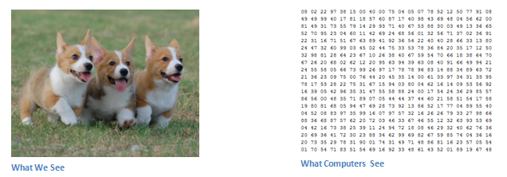
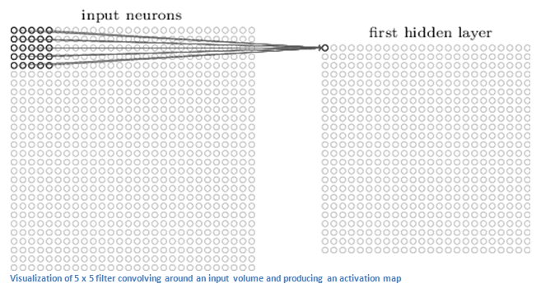
Convolution (conv) layer: Example: From the input layer to the first hidden layer
The first hidden layer represents the filter outputs of a certain feature
So, what is a feature?
Answer is in the next slide

Slide 11
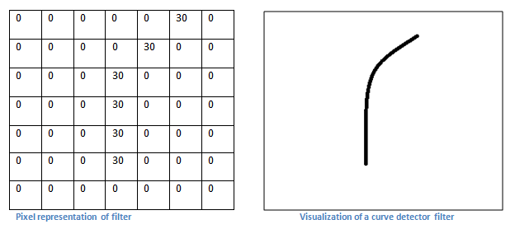
Convolution (conv) layer Idea of a feature identifier
We would like to extract a curve (feature) from the image
Input picture

Slide 12
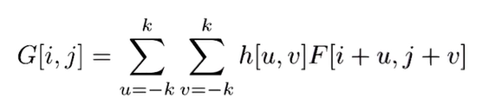
We first learn discrete (cross) correlation
Example
a=[1 3 4
2 7 1
0 5 2]
b=[4 1
2 7]
G =
G=
7 23 34 8
15 60 37 18
2 50 53 8
0 5 22 8
4*5+2*1=22
1*4+2*2+3*1+7*7=60
0*1=0
4*0+5*1=5
https://www.youtube.com/watch?app=desktop&v=C3EEy8adxvc

Slide 13
Discrete convolution: Correlation is more intuitive
So, we use correlation of the flipped version of h to implement convolution[1]
$$I=\left[\begin{matrix}1 & 4 & 1 \\ 2 & 5 & 3\end{matrix}\right],h=\left[\begin{matrix}1 & 3 \\ 2 & −4\end{matrix}\right],\text{find} I∗h$$
convolution
$$C(m,n)=\sum_{j=−∞}^{j=∞}{\sum_{k=−∞}^{k=∞}{h(m−j,n−k)×I(j,k)}} \\ =\sum_{j=−∞}^{j=∞}{\sum_{k=−∞}^{k=∞}{h^{(flip)}(−m+j,−n+k)×I(j,k)}}$$
Flipped h
correlation

Slide 14
Matlab (octave) code for convolution
I=[1 4 1;
2 5 3]
h=[1 3 ;
2 -4]
conv2(I,h)
pause
disp('It is the same as the following');
conv2(h,I)
pause
disp('It is the same as the following');
xcorr2(I,fliplr(flipud(h)))
Flipped h=
-4 | 2
3 | 1

Slide 15
Steps to find C(m,n)
Step1:
C(0,0)
=2x2=4
Step 2:
C(1,0)
= -4*2+2*5=2
Step 3:
C(2,0)
= -4*5+2*3
=-14
Step 4:
C(3,0)
= -4*3
=-12
1 | 4 | 1
2 | 5 | 3
1 | 4 | 1
2 | 5 | 3
-4 | 2
3 | 1
-4 | 2
3 | 1
Flipped h
1 | 4 | 1
2 | 5 | 3
1 | 4 | 1
2 | 5 | 3
-4 | 2
3 | 1
-4 | 2
3 | 1
C(0,0) | C(1,0) | C(2,0) | C(3,0)
C(0,0) | C(1,0) | C(2,0) | C(3,0)
C(0,0)=4 | C(1,0)=2 | C(2,0)=-14 | C(3,0)=-12
C(m,n)=

Slide 16
Steps continue
1 | 4 | 1
2 | 5 | 3
Step 5:
C(0,1)
=1*2+2*1
=4
Step 6:
C(1,1)
= 1*-4+2*3+4*2+5*1
=15
Step 7:
C(2,1)
= -4*4+5*3+1*2+3*1
=4
Step 8:
C(3,1)
= -4*1+3*3
=5
1 | 4 | 1
2 | 5 | 3
-4 | 2
3 | 1
-4 | 2
3 | 1
1 | 4 | 1
2 | 5 | 3
-4 | 2
3 | 1
1 | 4 | 1
2 | 5 | 3
-4 | 2
3 | 1
C(0,2) | C(1,2) | C(2,2) | C(3,2)
C(0,1)=4 | C(1,1)=15 | C(2,1)=4 | C(3,1)=5
C(0,0)=4 | C(1,0)=2 | C(2,0)=-14 | C(3,0)=-1
C(m,n)=

Slide 17
Find all elements
-4 | 2
3 | 1
-4 | 2
3 | 1
-4 | 2
3 | 1
-4 | 2
3 | 1
1 | 4 | 1
2 | 5 | 3
1 | 4 | 1
2 | 5 | 3
1 | 4 | 1
2 | 5 | 3
1 | 4 | 1
2 | 5 | 3
n
$$=\left[\begin{matrix}1 & 7 & 13 & 3 \\ 4 & 15 & 4 & 5 \\ 4 & 2 & −14 & −12\end{matrix}\right]$$
C(m,n)
n
m
m

Slide 18
Worksheet 3.1
I=[1 4 1;
2 5 3
3 5 1]
h2=[-1 2
3 4]
Find convolution of I and h2.

Slide 19
Answer ws5711_3_1
%ws3.1 edge
I=[1 4 1;
2 5 3
3 5 1]
h2=[-1 2
3 4]
%Find convolution of I and h2.
conv2(I,h2)
ans =
-1 -2 7 2
1 15 26 10
3 24 38 14
9 27 23 4

Slide 20
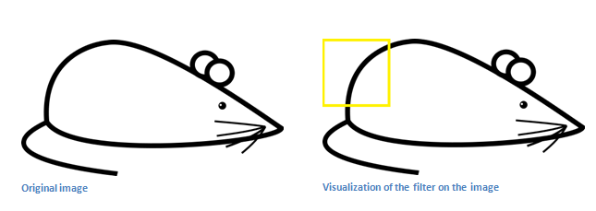
Convolution (conv) layer The curve feature in an image
So, for this part of the image, there is such as a curve feature to be found.
Example of a curve feature map: If that cell is high , that means there is such a curve feature in the box of the input image

Slide 21
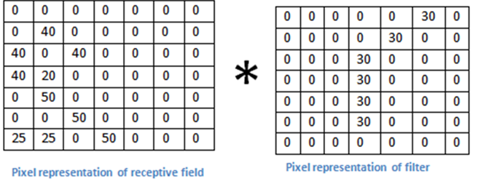

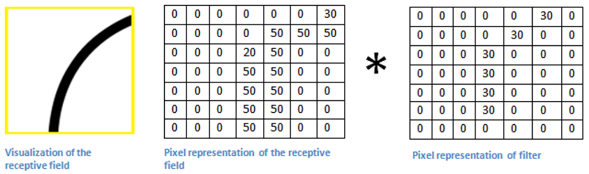
Convolution (conv) layer: What does it do? Convolution is implemented by correlation
Correlation(X,B)=multiplication of summation of image I and B= 0.
Image X has no curve feature B
Input image=X
A curve feature=B
Correlation(A,B)=Multi_and_Sum= 3*(30*50)+(20*30)+50*30=6600 is large . That means image A has curve feature B
Input image=A
A curve feature=B

Slide 22
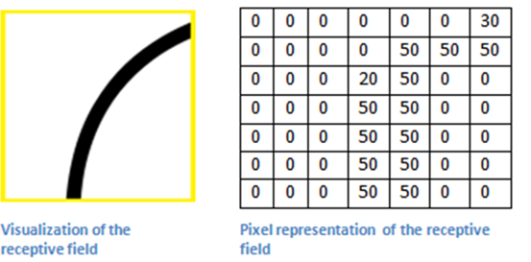
Exercises on CNN Exercise 1: Convolution (conv) layer. How to find the curve feature
Exercise on convolution (implemented by correlation).
Find Y=correlation( A,C). If Y>5000, image A has feature C
Answer_________?
What does the result of correlation ( A,C) represent?
Answer:___________________________________
A=
=C (empty cell = 0)
 | 30
 |  | 30
 |  |  | 30
 |  | 30
 |  | 30
 |  |  | 30
 |  |  |  | 30
*

Slide 23
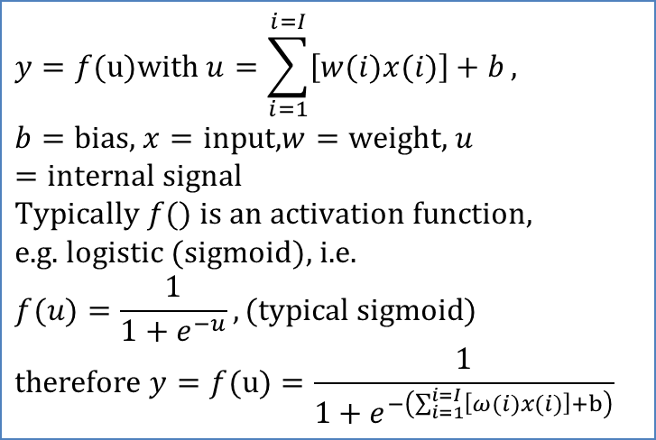
To complete the convolution layer
After convolution (multiplication and summation) the output is passed on to a non-linear activation function (Sigmoid or Tanh or Relu), same as Back –Propagation NN.
We can use a neuron to simulate correlation, such as
u is generated by: u=correlation(x,w)
$$y=f(u)\text{with} u=\sum_{i=1}^{i=I}{\left[w(i)x(i)\right]+b}, \\ b=\text{bias}\text{, }x=\text{input}\text{,}w=\text{weight}\text{, }u=\text{internal} \text{signal} \\ \text{Typically} f() \text{is} \text{an} \text{activation} \text{function}\text{,} \\ \text{e}\text{.}\text{g}\text{. }\text{logistic} (\text{sigmoid})\text{, }\text{i}\text{.}\text{e}\text{.} \\ f(u)=\frac{1}{1+e^{−u}},\text{(}\text{typical} \text{sigmoid}\text{)} \\ \text{therefore} y=f(u)=\frac{1}{1+e^{−\left(\sum_{i=1}^{i=I}{\left[ω(i)x(i)\right]+b}\right)}}$$

Slide 24
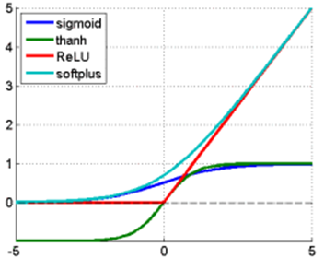
Activation function/gradient choices
https://imiloainf.wordpress.com/2013/11/06/rectifier-nonlinearities/
https://www.simonwenkel.com/2018/05/15/activation-functions-for-neural-networks.html#softplus
$$\text{Sigmoid} (\text{from}\text{ 0 }\text{to}\text{ 1}): \\ g\left(x\right)=\frac{1}{1+e^{x}},$$
$$gradient=\frac{dg(x)}{dx}=g(x)⋅(1−g(x))$$
$$\text{Tanh} (\text{from}\text{ −1 }\text{to}\text{ 1}): \\ g\left(x\right)=\frac{\sinh{(}x)}{\cosh{(}x)},$$
$$gradient=\frac{dg(x)}{dx}=\frac{4}{{\left(e^{−x}+e^{x}\right)}^{2}}$$
$$\text{Rectified} \text{Linear} \text{Unit} \left(Relu\right)\left(\text{from}\text{ 0 }\text{to} ∞\text{,}\text{hard} \text{change}\right):$$
$$g(x)=\max{(}0,x),$$
$$gradient=\frac{dg(x)}{dx} =\left\{\begin{matrix}1, \text{if} \text{x}≥0 \\ 0, \text{if} \text{x}<0\end{matrix}\right.$$
$$\text{Softplus} (\text{from}\text{ 0 }\text{to} ∞\text{,}\text{soft} \text{change})\text{: } \\ g(x)=\ln{(}1+e^{x}),gradient=\frac{dg(x)}{dx}=\frac{1}{1+e^{−x}}$$
Max. gradient of Signmoid is 0.25, it will cause the vanishing gradient problem
Relu is now very popular and shown to be working better other methods

Slide 25
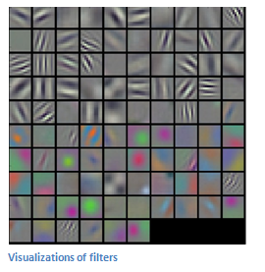
Example (LeNet)
An implementation example http://yann.lecun.com/exdb/lenet/
Input C1:conv. S2:subs. C3:conv S4:subs C5:fully F6:fully output
Each feature filter uses one kernel (e.g. 5x5) to generate a feature map
Each feature map represents the output of a particular feature filter output.
Alternating Convolution (conv) and subsampling layer (subs) (optional, some systems skip subs)
Subsampling allows the features to be flexibly positioned
(array of feature maps

Slide 26
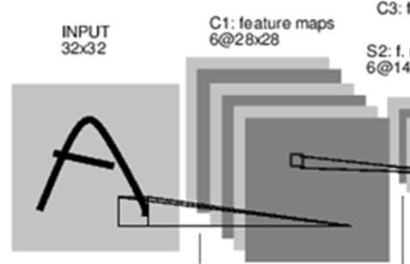
Input → C1: Input to convolution
For each 5x5 kernel (or called kernel) you need 5x5 weights (per convolution layer NN) . Unlike a fully connected Neural Net, the weights are shared. Meaning that, when you convolve the kernel with the input , only one set of 5x5 kernel (weights) is used for the convolution.
Convolution layer
Input →one feature map, you only need 5x5 weights , one bias
For 6 feature maps you need 6x5x5 weights. (very efficient)
(To compare with a fully connected NN) If this is to be implemented by a fully connected layer without convolution
You need 32x32x28x28 weights.
For 6 feature maps need 6x 32x32x28x28 (not efficient)
Training by backpropagation is the same as a common back propagation neural network BPNN.
The filter (kernel) is like a feature extractor
Each filter has one bias
6x28x28
32x32
Convolution layer
5x5 kernel
From input to one of the 6 convolution maps
https://stanford.edu/~shervine/teaching/cs-230/cheatsheet-convolutional-neural-networks
One bias per kernel (or called filter)
No bias for max pooling

Slide 27
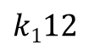
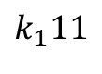
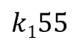
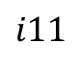
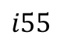
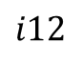
Example of how one feature map is formed If you need 6 feature maps, you need 6 kernels maps (K_{j=1.,,,6}) and perform 6 sets of correlations(K_{j},i), for j=1,,6
The kernel (flipped) 5x5 K_{j=1} is
The 5x5 image window (i) is
K₁11 | K₁12 | K₁13 | K₁14 | K₁15
K₁21 | K₁22 | . | . | .
. | . | .
 |  |  |  | K₁55
Convolution layer
5x5 kernel
Conv2() is 2D convolution
Sigmoid
$$i11$$
$$k_{1}11$$
Output
Of the
kernel
$$i12$$
$$k112$$
i11 | i12 | i13 | i14 | i15
i21 | i22 | . | . | .
. | . | .
 |  |  |  | i55
$$i55$$
$$k155$$
correlation(K_{j=1},i)
This process (correlation) is the same as convolution depends on how you index the kernel.

Slide 28
Example
%A 2X2 WINDOW FROM THE INPUT IMAGE IS I
i=[0.21 0.13
0.24 0.42]
%KERNEL IS 2X2, BIAS B= 0.6
K=[0.1 0.31
0.23 0.12]
B=0.6
C=0.21*0.1+0.24*0.23+0.13*0.31+0.42*0.12 %=use correlation (assume K is already up_down and left_right flipped.)
U=sum(sum(C))+ B
Output=1/(1+exp(-(U)))
%ANS: 0.6828
See https://towardsdatascience.com/convolution-vs-correlation-af868b6b4fb5
$$f(u)=\frac{1}{1+e^{−u}}$$

Slide 29
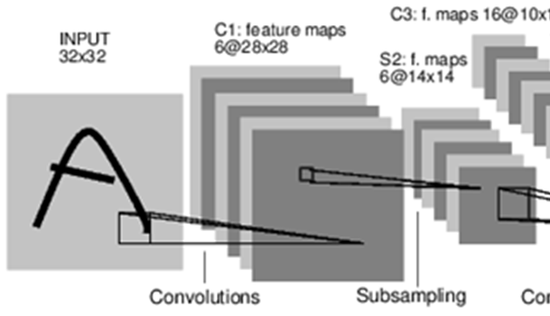
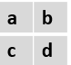
C1→ S2: From convolution maps (C1) to subsampling to maps (S2)
No weights involved, just by calculation
Sample s=( )
One layer to the next corresponding layer, no cross layer connections.
It can be achieved by one of two methods:
Average pooling : s=(a+b+c+d)/4, or
Max pooling : s= max(a,b,c,d)
From convolution maps to subsampling to maps
Normally a convolution layer is followed by a subsample layer, but it is also possible to connect a convolution layer directly to another convolution layer without a subsample layer, it is up to the designer to choose.
No bias for max pooling or averaging
https://www.mathworks.com/matlabcentral/answers/350254-why-there-is-no-bias-and-coefficient-trainable-parameters-in-the-max-and-average-pooling-layers

Slide 30
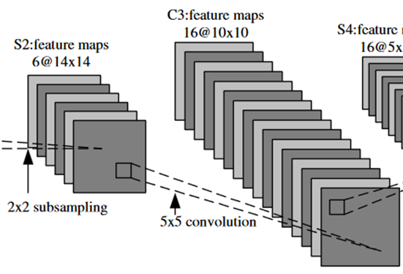
S2→C3: From subsampling maps (S2) to the next convolution layer (C3)
For each element in the C3 (feature) map, it is connected to all 6 feature maps from S2.
You need 5x5 weights for each input from each S2 map, so altogether you need 6x(5x5) weights to generate a C3 feature map from all 6 S2 feature maps.
How to add up the input to become the output depends on your design. Will show later
For all 16 feature maps of C3, you need 16x(6x(5x5)) weights.

Slide 31
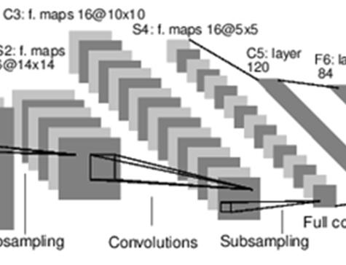
C3→S4:From subsampling maps (C3) to the next convolution layer (S4)
No weights involved, just by calculation
Sample s=( )
One layer to the next corresponding layer, no cross layer connections.
It can be achieved by two methods:
Average pooling: s=(a+b+c+d)/4, or
Max pooling : s= max(a,b,c,d)
From C3→S4

Slide 32
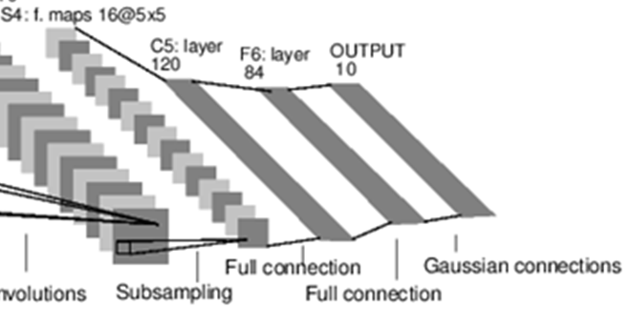
S4→C5: From fully connection layer (S4) to a fully connection vector (C5), and so on
F6→output
C5→F6
S4→C5
Fully connection vector
Each element in the fully connection vector (C5) connects to all elements in S4 (S4 has 16x5x5 neurons). Therefore, we need 120x(16x5x5) weights
Likewise, from C5 to F6, you need 120x84 weights
From F6 to output , you need 84x10 weights.

Slide 33
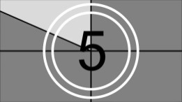
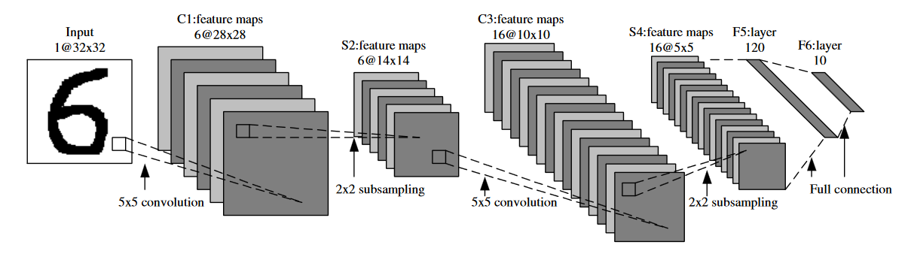

Exercise2 and Demo (click image to see demo)
http://deeplearning.stanford.edu/wiki/images/6/6c/Convolution_schematic.gif , https://link.springer.com/content/pdf/10.1007%2F978-3-642-25191-7.pdf
1 | 0 | 1
0 | 1 | 0
1 | 0 | 1
This is a 3x3 mask(kernel) for illustration purpose,
but noted that the above application uses a 5x5 mask (kernel).
Input image
A different kernel generates a different feature map.
Use softmax to generate the output (see next slide)
A feature map
X
Y
Correlation mask (kernel) .
Exercise 2: (a) Find X,Y. Answer:X=_______? , Y=_______?
(b) Find X again if the correlation mask (or kernel) is [0 2 0;
2 0 2;
0 2 0].
Answer:X_{new}=____?

Slide 34
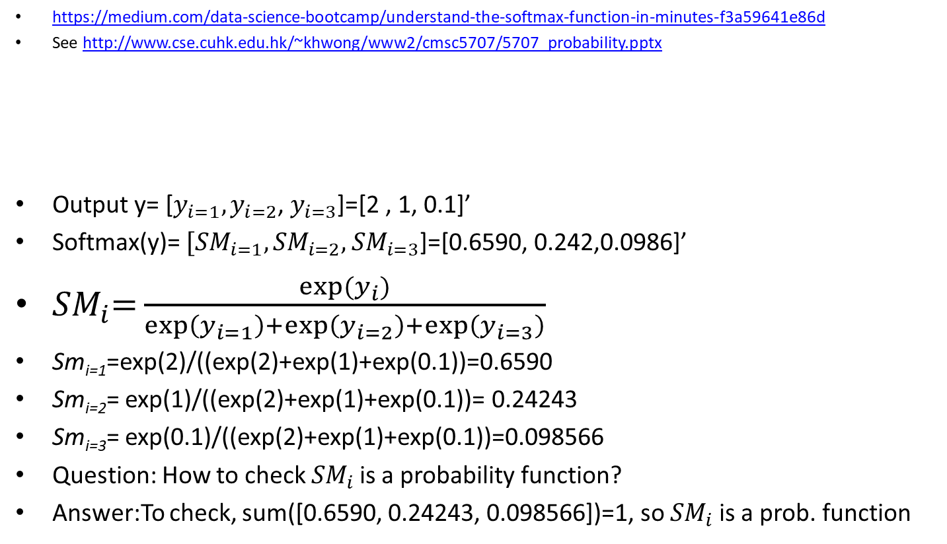
Softmax (SM) function This is to make sure the output is a probability distributed function (value from 0 to 2)
https://medium.com/data-science-bootcamp/understand-the-softmax-function-in-minutes-f3a59641e86d
See http://www.cse.cuhk.edu.hk/~khwong/www2/cmsc5707/5707_probability.pptx
Output y= [$y_{i=1},y_{i=2}$, $y_{i=3}$]=[2 , 1, 0.1]’
Softmax(y)= ${[SM}_{i=1},{SM}_{i=2},$ ${SM}_{i=3}$]=[0.6590, 0.242,0.0986]’
${SM}_{i}\text{=}\frac{\exp{(}y_{i})}{\exp\left(y_{i=1}\right)+\exp\left(y_{i=2}\right)+\exp\left(y_{i=3}\right)}$
Sm_{i=1}=exp(2)/((exp(2)+exp(1)+exp(0.1))=0.6590
Sm_{i=2}= exp(1)/((exp(2)+exp(1)+exp(0.1))= 0.24243
Sm_{i=3}= exp(0.1)/((exp(2)+exp(1)+exp(0.1))=0.098566
Question: How to check ${SM}_{i}$is a probability function?
Answer:To check, sum([0.6590, 0.24243, 0.098566])=1, so ${SM}_{i}$ is a prob. function
$${SM}_{i}\text{=}\text{softmax}(y_{i})=\frac{\exp{(}y_{i})}{\sum_{i=1}^{n}{\exp{(}y_{i})}},\text{for} i=1,2,..,n$$
0.6590, 0.24243, 0.098566
${SM}_{i=1}$ ${SM}_{i=2}$ ${ SM}_{i=3}$
SoftMax
$y_{i=1} y_{i=2}$ $y_{i=3}$
2 1 0.1

Slide 35
Description of the layers
Subsampling
Layer to layer connections

Slide 36
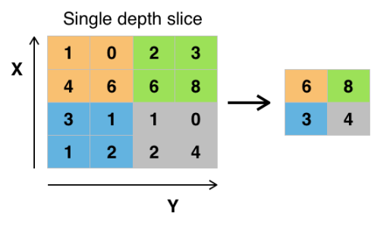
Subsampling (subs)
Subsampling allows features to be flexibly positioned around a specific area, example:
Subsample an output (a matrix of 2x2)
Sample s=( )
It can be achieved by two methods:
Average pooling: s=(a+b+c+d)/4, or
Max pooling : s= max(a,b,c,d)
a | b
c | d
Max pooling
https://en.wikipedia.org/wiki/Convolutional_neural_network#/media/File:Max_pooling.png

Slide 37
Exercise 3: A small example of how the feature map is calculated
output feature map 5x5
Input image 7x7
Kernel 3x3
Correlation
with
For each dimension, N=image_width, m=kernel (mask) width, s=step size, output_feature_map_width={ [(N-m)/s]+1}
If the step size of the correlation is 1 pixel (horizontally and vertically), explain why the above output feature map is 5x5.
If input is 32x32, mask is 5x5, what is the size of the output feature map if step size is 1? Answer: _______
If input is 28x28, what is the size of the subsample layer? Answer:________
If input is 14x14, kernel=5x5, what is the size of the output feature map if step size is 1? Answer:__________
In question(a), if the step size of the convolution is 2 pixels, What is the size of he output feature map. Answer:____________? 3x3
Zero padding may be added to the input image if (N-m)/s is not an integer, see
https://deeplizard.com/learn/video/qSTv_m-KFk0

Slide 38
Zero padding (p) in CNN
A square image is NxN=128x128, a Convolution Neural Network CNN is using a kernel of size mxm=7x7, step size (stride) =3. Find the feature map size DxD.
Use the formula D=(((N-m)/s)+1)=(((128-7)/3)+1)=41.3, not an integer, so what to do?
Use the formula D=(((N-m+2*p)/s)+1)= output_feature_map_width (must be an integer)
p=Zero-padding (add ‘0’ to the input image, each side is p pixels), p is an integer and use the smallest value of p to make D an integer.
In case the result D is not an integer,
Therefore, N=128,m=7,s=3, make p=1
D=(((N-m+2*p)/s)+1)=(((128-7+2)/3)+1)=42
Image after zero padding
p
Original image
p
p
White areas: Zeros are added to the image
Ref : https://datahacker.rs/what-is-padding-cnn/

Slide 39
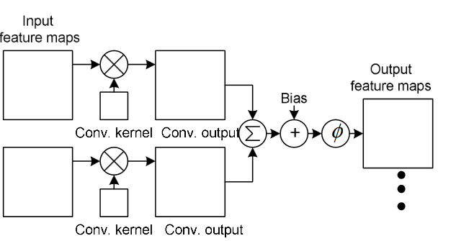
How to feed one feature layer to multiple features layers
Layer 1 Layer 2 Layer 3 Layer 4 Layer 5 Layer 6
6 feature maps
You can combine multiple feature maps of one layer into one feature map in the next layer
See next slide for details
https://link.springer.com/content/pdf/10.1007%2F978-3-642-25191-7.pdf

Slide 40
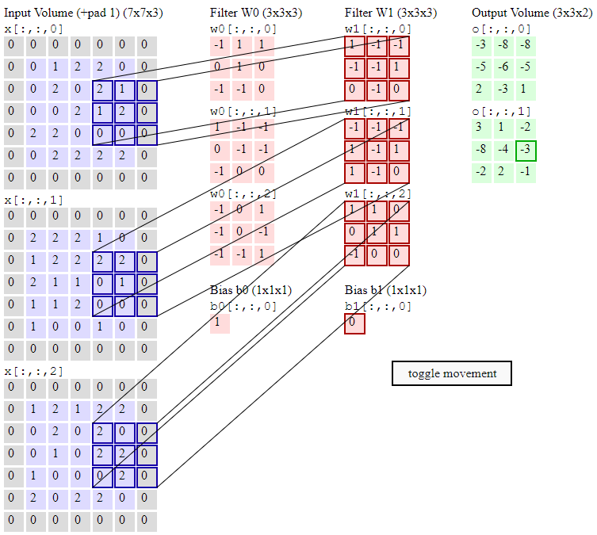
Example: This is to show how to use 3 input features maps (e.g. RGB color) to become 2 output maps

Slide 41
A demo
2*1+1*-1+1*-1+2*-1
+
2*-1+2*-1+1*-1
+
2*1+2*1= -3
By adding 3 correlation results
Input is three 7x7 images (e.g. RGB)
Shift step size is 2 pixels rather than 1, therefore the output is 3x3 for each feature map
Generate 2 output feature maps
0[:,:,0]
0[:,:,1]
https://youtu.be/vAh_ZHtyJ0k demo video
http://cs231n.github.io/convolutional-networks/

Slide 42
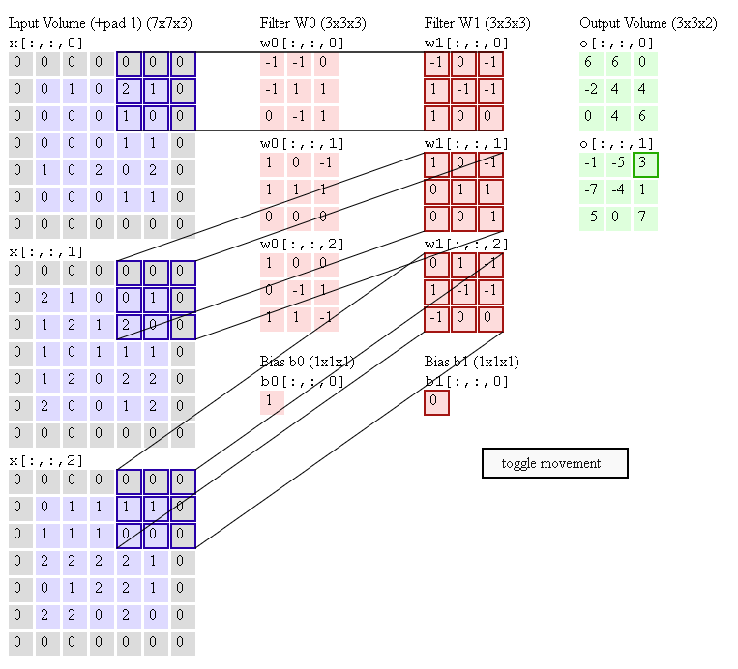
Exercise 4 and another demo
2*1+1*(-1)+1*1+
1*1+
1*1+1*(-1)=3
Input is a 3 7x7 image (e.g. RGB)
Shift step size is 2 pixels rather than 1, therefore the output is 3x3 for each feature map
Generate 2 output feature maps
0[:,:,0]
0[:,:,1]
Exercise 4: verify the results in outputs:
0[:,:,0] and 0[:,:,1]
Input (In)
In ⊗ w0
In ⊗ w1
⊗=convolution
1*(-1)+
2*1+1*(1)+2*(-1)+
1*(-1)=-1
http://cs231n.github.io/convolutional-networks/

Slide 43
Example
Using a program

Slide 44
Example: Overview of Test_example_CNN.m
Read data base
Part I:
cnnsetup.m
Layer 1: input layer (do nothing)
Layer 2→ convolution(conv.) Layer, output maps=6, kernel size=5x5
Layer 3→ sub-sample (subs.) Layer, scale=2
Layer 4→ conv. Layer, output maps =12, kernel size=5x5
Layer 5→ subs. Layer (output layer), scale =2
Part 2:
cnntrain.m % train weights using 60,000 samples
cnnff( ) % CNN feed forward
cnndb( ) % CNN feed back to train weighted in kernels
cnnapplygrads( ) % update weights
cnntest.m % test the system using 10000 samples and show error rate
Matlab example based on
http://www.mathworks.com/matlabcentral/fileexchange/38310-deep-learning-toolbox

Slide 45
Architecture example
Layer 3→4:
12 conv.
Maps (C)
InputMaps=6
OutputMaps=12
Fan_in=
6x5²=150
Fan_out=
12x5²=300
Layer 1→2:
6 conv.Maps (C)
InputMaps=6
OutputMaps=6
Fan_in=5²=25
Fan_out=6x5²=150
Layer 2→3:
6 sub-sample
Map (S)
InputMaps=6
OutputMaps=12
Layer 4→5:
12 sub-sample
Map (S)
InputMaps=12
OutputMaps=12
Each output neuron corresponds to a character (0,1,2,..,9 etc.)
Layer 1:
One input (I)
Layer 1:
Image
Input
1x28x28
Layer 5
(subsample):
12x4x4
Layer 2
(hidden):
6x24x24
Layer 3
(subsample):
6x12x12
Layer 4
(hidden):
12x8x8
10
outputs
Conv.
Kernel
=5x5
Subs
Kernel
=5x5
Conv.
2x2
Subs
I=input
C=Conv.=convolution
S=Subs=sub sampling or mean or max pooling
2x2

Slide 46
Data used in training of a neural networks
Training set
Around ≈ 60-70 % of the total data
Used to train the system
Validation set (optional)
Around ≈ 10-20 % of the total data
Used to tune the parameters of the model of the system
Test set
Around ≈ 10-20 % of the total data
Used to test the system
Data in the above sets cannot be overlapped, the exact % depends on applications and your choice.

Slide 47
Warning: How to train a neural network to avoid data over fitting
Over-fitting: the system works well for training data but not testing data, so extensive training may not help.
What should we do: Use validation data to tune (number of layers, activation functions etc) the system to reduce the test error at early stop.
Error from loss function
Test error curve using testing data
Early stopping
test error at early stop
Training cycles (epoch)
Training error using training data
https://stats.stackexchange.com/questions/131233/neural-network-over-fitting

Slide 48
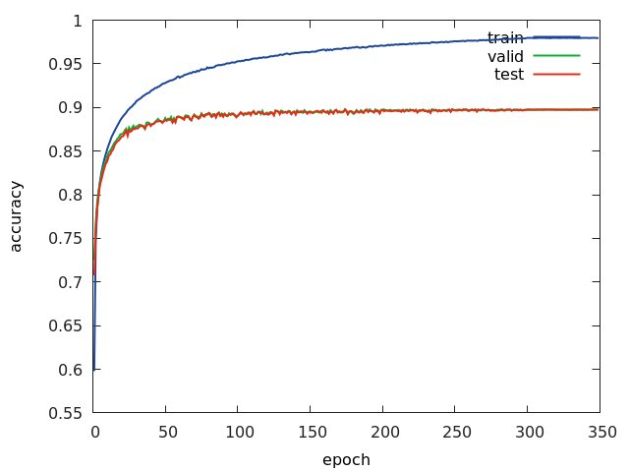
Same idea from the view point of accuracy
https://www.researchgate.net/publication/313508637_Detection_and_characterization_of_Coordinate_Measuring_Ma-_chine_CMM_probes_using_deep_networks_for_improved_quality_assurance_of_machine_parts/figures?lo=1
By https://www.researchgate.net/profile/Binu_Nair

Slide 49
Transfer learning for deep net (e.g. over 50 layers): leaning using pre-trained weights
Take long tine to train and require a lot of data.
Can be very efficient to tarin
Use
Pre-trained-CNN NEW TASK
https://neptune.ai/blog/transfer-learning-guide-examples-for-images-and-text-in-keras
https://medium.datadriveninvestor.com/introducing-transfer-learning-as-your-next-engine-to-drive-future-innovations-5e81a15bb56 7

Slide 50
How to implement transfer learning
https://neptune.ai/blog/transfer-learning-guide-examples-for-images-and-text-in-keras

Slide 51
Step1 : Obtain the pre-trained model
The first step is to get the pre-trained model that you would like to use for your problem. The various sources of pre-trained models are covered in a separate section
There are more than two dozen pre-trained models available from Keras. They’re served via Keras applications.

Slide 52
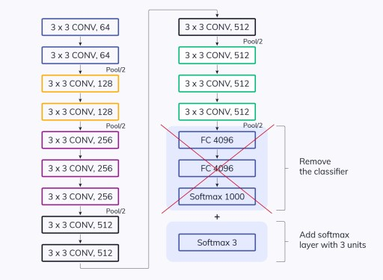
Step2 : Create a base model
Usually, the first step is to instantiate the base model using one of the architectures such as ResNet or Xception. You can also optionally download the pre-trained weights. ….

Slide 53
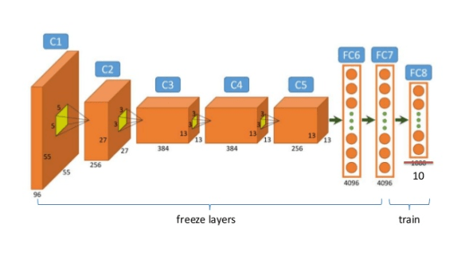
Step3 : Freeze layers
So, they don’t change during training

Slide 54
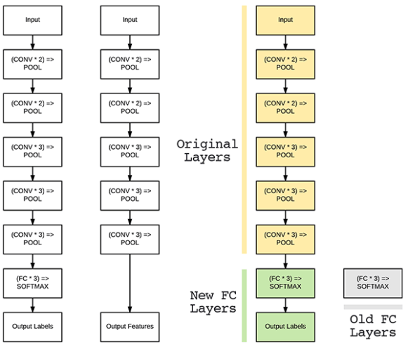
Step4 : Add new trainable layers

Slide 55
Step 5: Train the new layers on the dataset
Remember that the pre-trained model’s final output will most likely be different from the output that you want for your model. For example, pre-trained models trained on the ImageNet dataset will output 1000 classes

Slide 56
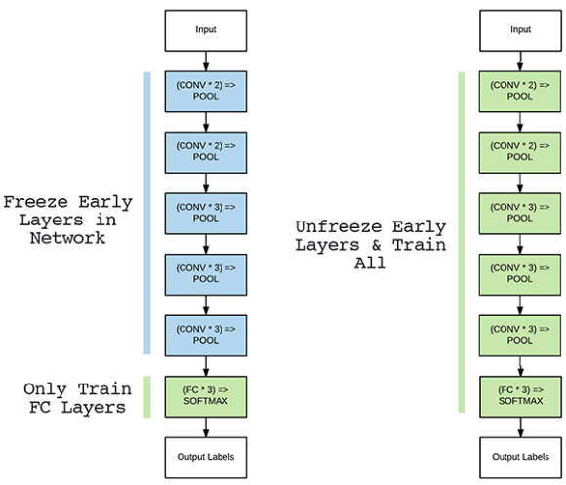
Step 6: Improve the model via fine-tuning

Slide 57
Part A.2 Feedforward details for reference using a MATLAB program
Feed forward part of
cnnff( )
Matlab example
http://www.mathworks.com/matlabcentral/fileexchange/38310-deep-learning-toolbox

Slide 58
Cnnff.m Convolution Neural Networks feed forward
This is the feed forward part
Assume all the weights are initialized or calculated, we show how to get the output from inputs.
Ref: CNN Matlab example http://www.mathworks.com/matlabcentral/fileexchange/38310-deep-learning-toolbox

Slide 59
Layer 1→2 (Input to hidden):
Convolute layer 1 with different kernels (map_index1=1,2,.,6) and produce 6 output maps
Inputs :
input layer 1, a 28x28 image
6 different kernels : k(1),.,,,k(6) , each k is 5x5, K are dendrites of neurons
Output : 6 output maps each 24x24
Algorithm
For(map_index=1:6)
{
layer_2(map_index)=
I*k(map_index)_{valid}
}
Discussion
“Valid” means only consider overlapped areas, so if layer 1 is 28x28, kernel is 5x5 each, each output map is 24x24
In Matlab > use convn(I,k,’valid’)
Example:
I=rand(28,28)
k=rand(5,5)
size(convn(I,k,’valid’))
> ans > 24 24
Layer 1:
One input (I)
Layer 1→2:
6 conv.Maps (C)
InputMaps=6
OutputMaps=6
Fan_in=5²=25
Fan_out=6x5²=150
Layer 1:
Image
Input (i)
1x28x28
Layer 2(c):
6x24x24
Map_index=
1
2
:
6
i
Conv.*K(1)
Kernel
=5x5
Conv.*K(6)
j
2x2
I=input
C=Conv.=convolution
S=Subs=sub sampling
1 kernel (K) convolves with the input image (i) to generate 1 output map. 6 kernels gives 6 maps. K is learned by backpropagation

Slide 60
Layer 2→3: (hidden to subsample)
Sub-sample layer 2 to layer 3
Inputs :
6 maps of layer 2, each is 24x24
Output : 6 maps of layer 3, each is 12 x12
Algorithm
For(map_index=1:6)
{
For each input map, calculate the average of 2x2 pixels and the result is saved in output maps.
Hence resolution is reduced from 24x24 to 12x12
}
Discussion
Layer 2→3:
6 sub-sample
Map (S)
InputMaps=6
OutputMaps=12
Layer 2 (c):
6x24x24
Layer 3 (s):
6x12x12
Map_index=
1
2
:
6
Subs
2x2

Slide 61
Layer 3→4: (subsample to hidden)
Conv. layer 3 with kernels to produce layer 4
Inputs :
6 maps of layer3(L3{i=1:6}), each is 12x12
Kernel set: totally 6x12 kernels, each is 5x5,i.e.
K{i=1:6}{j=1:12}, each K{i}{j} is 5x5
12 bias{j=1:12} in this layer, each is a scalar
Output : 12 maps of layer4(L4{j=1:12}), each is 8x8
Algorithm
for(j=1:12)
{ for (i=1:6)
{clear z, i.e. z=0;
z=z+covn (L3{i}, k{i}{j},’valid’)] %z is 8x8
}
L4{j}=sigm(z+bais{j}) %L4{j} is 8x8
}
function X = sigm(P)
X = 1./(1+exp(-P));
End
Layer 3→4:
12 conv.
Maps (C)
InputMaps=6
OutputMaps=12
Fan_in=
6x5²=150
Fan_out=
12x5²=300
Layer3 L3(s):
6x12x12
Layer 4(c):
12x8x8
net.layers{l}.a{j}
Index=i=1:6
Index=j=1:12
:
Kernel
=5x5
Feature maps in the previous layer can be combined to become feature maps in next layer, see https://youtu.be/vAh_ZHtyJ0k demo video

Slide 62
Layer 4→5 (hidden to subsample)
Subsample layer 4 to layer 5
Inputs :
12 maps of layer4(L4{i=1:12}), each is 12x8x8
Output : 12 maps of layer5(L5{j=1:12}), each is 4x4
Algorithm
Sub sample each 2x2 pixel window in L4 to a pixel in L5
Layer 4→5:
12 sub-sample
Map (S)
InputMaps=12
OutputMaps=12
Layer 4:
12x8x8
Layer 5:
12x4x4
Subs
2x2
10

Slide 63
Layer 5→output: (subsample to output)
Subsample layer 4 to layer 5
Inputs :
12 maps of layer5(L5{i=1:12}), each is 4x4, so L5 has 192 pixels in total
Output layer weights: Net.ffW{m=1:10}{p=1:192}, total number of weights is 192
Output : 10 output neurons (net.o{m=1:10})
Algorithm
For m=1:10%each output neuron
{clear net.fv
net.fv=Net.ffW{m}{all 192 weight}.*L5(all corresponding 192 pixels)
net.o{m}=sign(net.fv + bias)
}
Discussion
Layer 4→5:
12 sub-sample
Map (S)
InputMaps=12
OutputMaps=12
Totally
192 weights for each output neuron
Each output neuron corresponds to a character (0,1,2,..,9 etc.)
net.o{m=1:10}
Layer 5 (L5{j=1:12}:
12x4x4=192
Totally 192 pixels
:
:
Same for each output neuron
10

Slide 64
Part A.3 Back propagation (similar to any backpropagation network, training the kernel weights and biases)
Back propagation part
cnnbp( )
cnnapplyweight( )

Slide 65
cnnbp( ) overview (output back to layer 5)
Ref: See http://en.wikipedia.org/wiki/Backpropagation

Slide 66
Calculate gradient
From later 2 to layer 3
From later 3 to layer 4
Net.ffW
Net.ffb found
The method is similar to a typical Back propagation neural network BPNN

Slide 67
Details of calc gradients
% part % reshape feature vector deltas into output map style
L4(c) run expand only
L3(s) run conv (rot180, fill), found d
L2(c) run expand only
%Part %% calc gradients
L2(c) run conv (valid), found dk and db
L3(s) not run here
L4(c) run conv(valid), found dk and db
Done , found these for the output layer L5:
net.dffW = net.od * (net.fv)' / size(net.od, 2);
net.dffb = mean(net.od, 2);

Slide 68
cnnapplygrads(net, opts)
For the convolution layers, L2, L4
From k and dk find new k (weights)
From b and db find new b (bias)
For the output layer L5
net.ffW = net.ffW - opts.alpha * net.dffW;
net.ffb = net.ffb - opts.alpha * net.dffb;
opts.alpha is to adjust learning rate

Slide 69
Part B: CNN Architectures
History and descriptions

Slide 70
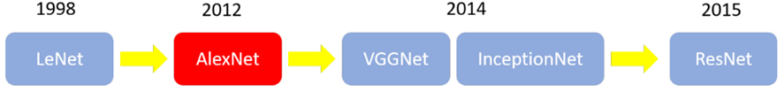
CNN Architectures:
LeNet
Alexnet,
VGGnet, Visual Geometry Group
Inception (GoogLeNet)
FCN, ResNet ,R-CNN, Faster-CNN
From 2015, YOLO1,2,3 SSD multibox, VOLO
Tools: See: [1] https://medium.com/雞雞與兔兔的工程世界/機器學習-ml-note-cnn演化史-alexnet-vgg-inception-resnet-keras-coding-668f74879306

Slide 71
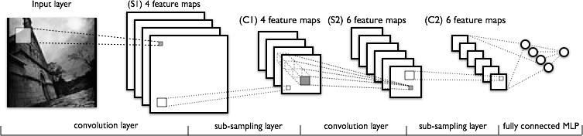
(i) LeNet
The classical CNN architecture
http://deeplearning.net/tutorial/lenet.html
You may use tensorflow “layers” or “keras” for the implementation

Slide 72
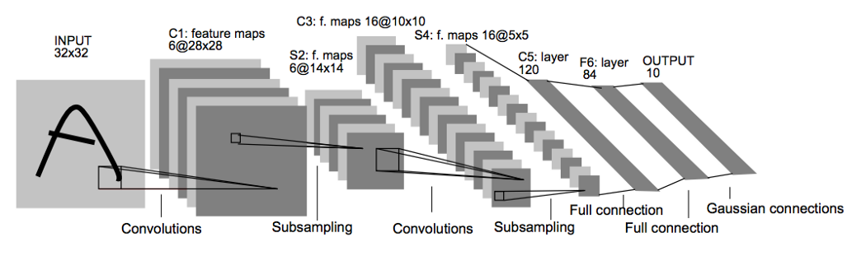
LeNet using layers
model = keras.Sequential() model.add(layers.Conv2D(filters=6, kernel_size=(3, 3), activation='relu', input_shape=(32,32,1))) model.add(layers.AveragePooling2D()) model.add(layers.Conv2D(filters=16, kernel_size=(3, 3), activation='relu')) model.add(layers.AveragePooling2D()) model.add(layers.Flatten()) model.add(layers.Dense(units=120, activation='relu')) model.add(layers.Dense(units=84, activation='relu')) model.add(layers.Dense(units=10, activation = 'softmax'))
https://medium.com/@mgazar/lenet-5-in-9-lines-of-code-using-keras-ac99294c8086
https://github.com/ianlewis/tensorflow-examples/blob/master/notebooks/TensorFlow%20MNIST%20tutorial.ipynb

Slide 73
LeNet using keras (Test accuracy: 0.992)
#modified from https://github.com/keras-team/keras/blob/master/examples/mnist_cnn.py
'''Trains a simple convnet on the MNIST dataset.
#khwong 2019 june 8
Gets to 99.25% test accuracy after 12 epochs
(there is still a lot of margin for parameter tuning).
16 seconds per epoch on a GRID K520 GPU.
'''
from __future__ import print_function
import tensorflow.keras as keras
from tensorflow.keras.datasets import mnist
from tensorflow.keras.models import Sequential
from tensorflow.keras.layers import Dense, Dropout, Flatten
from tensorflow.keras.layers import Conv2D, MaxPooling2D
from tensorflow.keras import backend as K
batch_size = 128
num_classes = 10
epochs = 12
# input image dimensions
img_rows, img_cols = 28, 28
# the data, split between train and test sets
(x_train, y_train), (x_test, y_test) = mnist.load_data()
if K.image_data_format() == 'channels_first':
x_train = x_train.reshape(x_train.shape[0], 1, img_rows, img_cols)
x_test = x_test.reshape(x_test.shape[0], 1, img_rows, img_cols)
input_shape = (1, img_rows, img_cols)
else:
x_train = x_train.reshape(x_train.shape[0], img_rows, img_cols, 1)
x_test = x_test.reshape(x_test.shape[0], img_rows, img_cols, 1)
input_shape = (img_rows, img_cols, 1)
x_train = x_train.astype('float32')
x_test = x_test.astype('float32')
x_train /= 255
x_test /= 255
print('x_train shape:', x_train.shape)
print(x_train.shape[0], 'train samples')
print(x_test.shape[0], 'test samples')
# convert class vectors to binary class matrices
y_train = keras.utils.to_categorical(y_train, num_classes)
y_test = keras.utils.to_categorical(y_test, num_classes)
model = Sequential()
model.add(Conv2D(32, kernel_size=(3, 3),
activation='relu',
input_shape=input_shape))
model.add(Conv2D(64, (3, 3), activation='relu'))
model.add(MaxPooling2D(pool_size=(2, 2)))
model.add(Dropout(0.25))
model.add(Flatten())
model.add(Dense(128, activation='relu'))
model.add(Dropout(0.5))
model.add(Dense(num_classes, activation='softmax'))
model.compile(loss=keras.losses.categorical_crossentropy,
optimizer=keras.optimizers.Adadelta(),
metrics=['accuracy'])
model.fit(x_train, y_train,
batch_size=batch_size,
epochs=epochs,
verbose=1,
validation_data=(x_test, y_test))
score = model.evaluate(x_test, y_test, verbose=0)
print('Test loss:', score[0])
print('Test accuracy:', score[1])

Slide 74
(ii) AlexNet
https://engmrk.com/alexnet-implementation-using-keras/
https://www.learnopencv.com/understanding-alexnet/
AlexNet
consists of 5 Convolutional Layers and 3 Fully Connected Layers
Overlapping Max Pooling
ReLU Nonlinearity
Reducing Overfitting
Data Augmentation
Dropout
Paper : https://papers.nips.cc/paper/4824-imagenet-classification-with-deep-convolutional-neural-networks.pdf

Slide 75
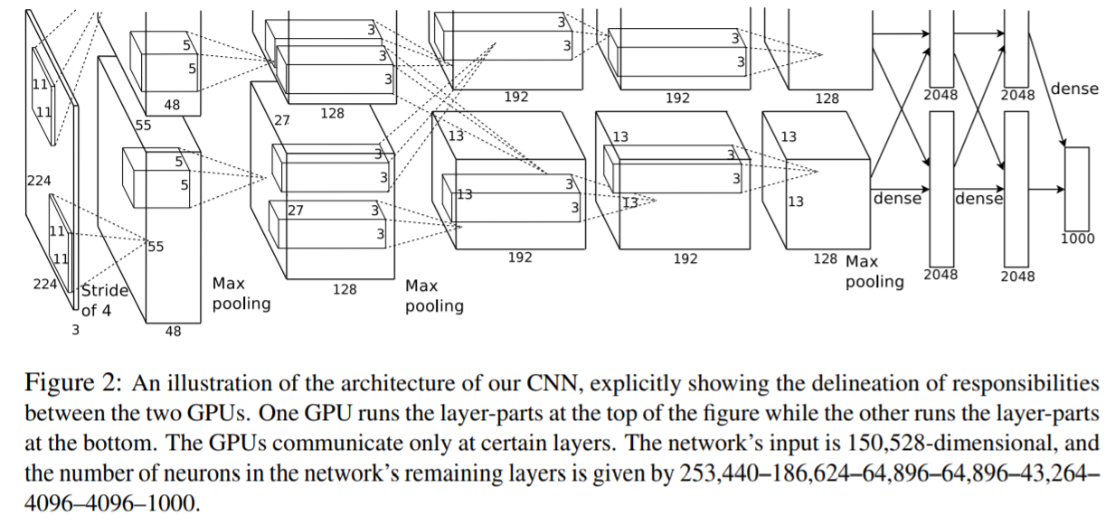
AlexNet
From the paper
https://papers.nips.cc/paper/4824-imagenet-classification-with-deep-convolutional-neural-networks.pdf

Slide 76
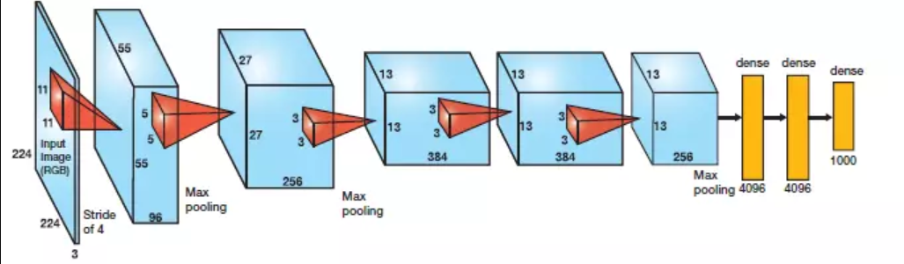
AlexNet
https://cv-tricks.com/tensorflow-tutorial/understanding-alexnet-resnet-squeezenetand-running-on-tensorflow/
Alex Krizhevsky first won Imagenet challenged in 2012 using a convolutional neural network for image classification task. Alexnet achieved top-5 accuracy of 84.6%

Slide 77
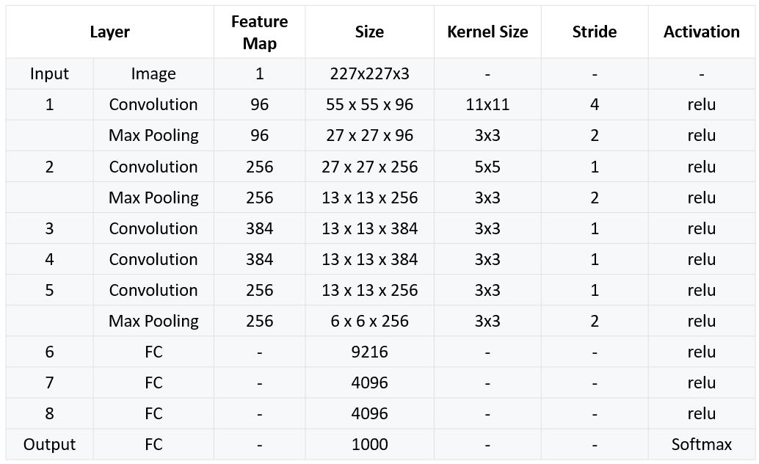
AlexNet
Architecture
https://engmrk.com/alexnet-implementation-using-keras/

Slide 78
AlexNet using keras
https://engmrk.com/alexnet-implementation-using-keras/
import keras from keras.models import Sequential from keras.layers import Dense, Activation, Dropout, Flatten, Conv2D, MaxPooling2D from keras.layers.normalization import BatchNormalization import numpy as np np.random.seed(1000)
#Instantiate an empty model model = Sequential()
# 1st Convolutional Layer model.add(Conv2D(filters=96, input_shape=(224,224,3), kernel_size=(11,11), strides=(4,4), padding=’valid’)) model.add(Activation(‘relu’)) # Max Pooling model.add(MaxPooling2D(pool_size=(2,2), strides=(2,2), padding=’valid’))
# 2nd Convolutional Layer model.add(Conv2D(filters=256, kernel_size=(11,11), strides=(1,1), padding=’valid’)) model.add(Activation(‘relu’)) # Max Pooling model.add(MaxPooling2D(pool_size=(2,2), strides=(2,2), padding=’valid’))
# 3rd Convolutional Layer model.add(Conv2D(filters=384, kernel_size=(3,3), strides=(1,1), padding=’valid’)) model.add(Activation(‘relu’))
# 4th Convolutional Layer model.add(Conv2D(filters=384, kernel_size=(3,3), strides=(1,1), padding=’valid’)) model.add(Activation(‘relu’))
# 5th Convolutional Layer model.add(Conv2D(filters=256, kernel_size=(3,3), strides=(1,1), padding=’valid’)) model.add(Activation(‘relu’)) # Max Pooling model.add(MaxPooling2D(pool_size=(2,2), strides=(2,2), padding=’valid’))
# Passing it to a Fully Connected layer model.add(Flatten()) # 1st Fully Connected Layer model.add(Dense(4096, input_shape=(224*224*3,))) model.add(Activation(‘relu’)) # Add Dropout to prevent overfitting model.add(Dropout(0.4))
# 2nd Fully Connected Layer model.add(Dense(4096)) model.add(Activation(‘relu’)) # Add Dropout model.add(Dropout(0.4))
# 3rd Fully Connected Layer model.add(Dense(1000)) model.add(Activation(‘relu’)) # Add Dropout model.add(Dropout(0.4))
# Output Layer model.add(Dense(17)) model.add(Activation(‘softmax’))
model.summary()
# Compile the model model.compile(loss=keras.losses.categorical_crossentropy, optimizer=’adam’, metrics=[“accuracy”])

Slide 79
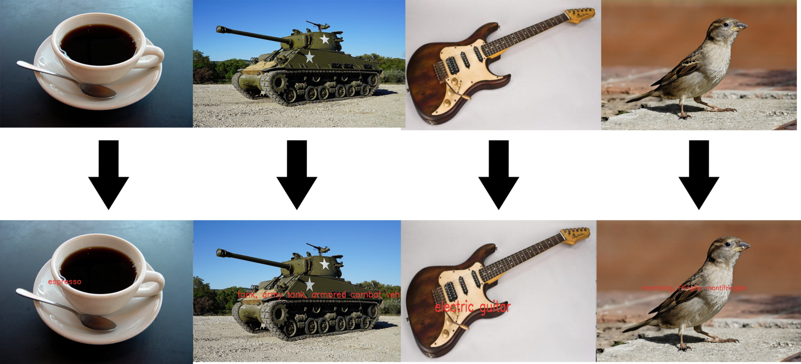
An implementation of AlexNet
May need to install the following version
pip install numpy==1.16.2
to make it work, i.e. 1.16.4 or higher may fail
https://github.com/felzek/AlexNet-A-Practical-Implementation
https://medium.com/coinmonks/understand-alexnet-in-just-3-minutes-with-hands-on-code-using-tensorflow-925d1e2e2f82
inputs
recognized results
Expresso Tank, army tank Electric Guitar Brambling,
Fringilla montifringilla 燕雀

Slide 80
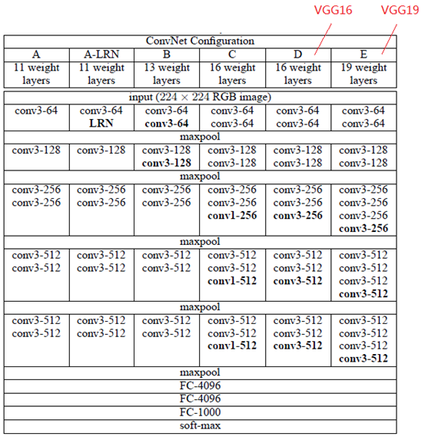
(iii) VGG Net
VGGNet, in 2014 ILSVRC rank number2 (first prize is InceptionNet)，VGGNet and AlexNet are similar , just difference in depth but can generate better result on the dataset oxflower17
However , training time is longer

Slide 81
VGGNet
http://www.robots.ox.ac.uk/~vgg/practicals/cnn/
Forward pass: Convolve C_{i} with W_{i} (kernel) to generate the next layer C_{i+1}
Backpropagation: Use gradient decent method [d(error)/dW_{i}] to update W_{i}

Slide 82
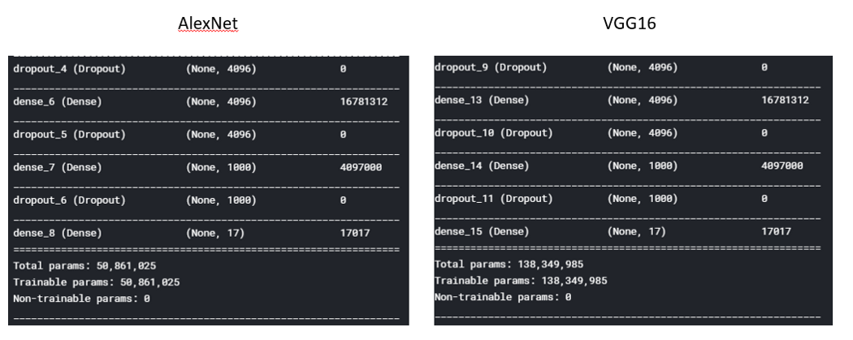
Comparison
AlexNet and VGG16

Slide 83
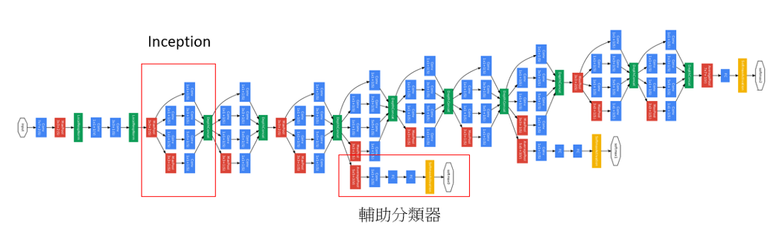
(iv) Inception (GoogLeNet)
GoogLeNet, in 2014 ILSVRC ranks number 1
The network structure is different from VGG or AlexNet
Use of Inception layer as shown below
Inception becomes InceptionV4 later
Auxiliary classifier

Slide 84
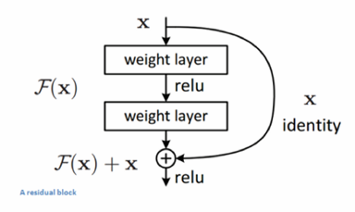
(v) ResNet
https://medium.com/@apiltamang/yet-another-resnet-tutorial-or-not-f6dd9515fcd7

Slide 85
(vi) Tools
Tensorflow , the current version includes Keras: The Python Deep Learning library
Microsoft CNTK
Caffé
Theano
Amazon Machine Learning
Torch
Brainstorm
http://www.it4nextgen.com/best-artificial-intelligence-frameworks/

Slide 86
Introduction-A study of popular neural network systems
CNN based
CNN (convolution neural network) (or LeNet ) 1998 https://en.wikipedia.org/wiki/Convolutional_neural_network
GoogleNet/Inception(2014) https://www.cs.unc.edu/~wliu/papers/GoogLeNet.pdf
FCN (Fully Convolution neural networks) 2015
https://people.eecs.berkeley.edu/~jonlong/long_shelhamer_fcn.pdf
VGG VERY DEEP CONVOLUTIONAL NETWORKS 2014
https://arxiv.org/pdf/1409.1556.pdf
ResNet https://en.wikipedia.org/wiki/Residual_neural_network 2015
Alexnet https://en.wikipedia.org/wiki/AlexNet 2012
(R-CNN) Region-based Convolutional Network by J.R.R. Uijlings and al. (2012)
RNN based
LSTM(-RNN) (long short term memory-RNN) 1997
https://en.wikipedia.org/wiki/Long_short-term_memory
Sequence to sequence approach
https://papers.nips.cc/paper/5346-sequence-to-sequence-learning-with-neural-networks.pdf

Slide 87
Problems
Object detection and recognition
Dataset
PASCAL Visual Object Classification (PASCAL VOC)
Common Objects in COntext (COCO)
Systems
Region-based Convolutional Network (R-CNN) by J.R.R. Uijlings and al. (2012)
Fast Region-based Convolutional Network (Fast R-CNN), developed by R. Girshick (2015)
Faster Region-based Convolutional Network (Faster R-CNN),. S. Ren and al. (2016)
Region-based Fully Convolutional Network (R-FCN), J. Dai and al. (2016)
You Only Look Once (YOLO) model (J. Redmon et al., 2016))
Single-Shot Detector (SSD),, W. Liu et al. (2016)
YOLO9000 and YOLOv2,. Redmon and A. Farhadi (2016)
Ahitecture Search Net (NASNet), The Neural Architecture Search (B. Zoph and Q.V. Le, 2017)
Another extension of the Faster R-CNN model has been released by K. He and al. (2017)
Object tracking
Speech recognition
Machine translation
https://medium.com/comet-app/review-of-deep-learning-algorithms-for-object-detection-c1f3d437b852

Slide 88
Summary
Studied the basic operation of Convolutional Neural networks (CNN)
Demonstrate how a simple CNN can be implemented

Slide 89
References
Wiki
http://en.wikipedia.org/wiki/Convolutional_neural_network
http://en.wikipedia.org/wiki/Backpropagation
Matlab programs
Neural Network for pattern recognition- Tutorial http://www.mathworks.com/matlabcentral/fileexchange/19997-neural-network-for-pattern-recognition-tutorial
CNN Matlab example http://www.mathworks.com/matlabcentral/fileexchange/38310-deep-learning-toolbox
CNN tutorial
http://cogprints.org/5869/1/cnn_tutorial.pdf

Slide 90
Appendix

Slide 91
Appendix: Fully Convolutional Networks for Semantic Segmentation
https://arxiv.org/pdf/1411.4038.pdf
https://arxiv.org/abs/1612.03144
https://people.eecs.berkeley.edu/~jhoffman/yahooJapan_Mar2016_talks/1-Evan-fcn%20spotlight.pdf
One implementation using Tensorflow
c # encode
conv1_1 = conv(inputs, 32, 3, strides=2, name='conv1_1')
conv1_2 = conv(conv1_1, 32, 3, name='conv1_2')
conv1_3 = conv(conv1_2, 32, 3, name='conv1_3')
conv2_1 = conv(conv1_3, 64, 3, strides=2, name='conv2_1')
conv2_2 = conv(conv2_1, 64, 3, name='conv2_2')
conv2_3 = conv(conv2_2, 64, 3, name='conv2_3')
conv3_1 = conv(conv2_3, 128, 3, strides=2, name='conv3_1')
conv3_2 = conv(conv3_1, 128, 3, name='conv3_2')
conv3_3 = conv(conv3_2, 128, 3, name='conv3_3')
conv4_1 = conv(conv3_3, 256, 3, strides=2, name='conv4_1')
conv4_2 = conv(conv4_1, 256, 3, name='conv4_2')
conv4_3 = conv(conv4_2, 256, 3, name='conv4_3')
conv5_1 = conv(conv4_3, 512, 3, strides=2, name='conv5_1')
conv5_2 = conv(conv5_1, 512, 3, name='conv5_2')
conv5_3 = conv(conv5_2, 512, 3, name='conv5_3')
# decode
upsample2 = deconv(conv5_3, 256, name='upsample2')
upsample2 = dropout(upsample2, rate=0.5, training=is_train, name='dropout1')
upsample4 = deconv(upsample2, 128, name='upsample4')
upsample4 = dropout(upsample4, rate=0.5, training=is_train, name='dropout2')
upsample_concat = tf.concat([upsample4, conv3_3], axis=3, name='concat_8s')
logits = conv(upsample_concat, num_classes, 1, do_act=False, name='logits')
logits = tf.image.resize_images(logits, tf.shape(inputs)[1:3], method=1, align_corners=True)
return logits
Fully Convolutional Networks for Semantic Segmentation
Jonathan Long∗ Evan Shelhamer∗ Trevor Darrell
UC Berkeley

Slide 92
Image dataset CIFAR10/100
https://www.cs.toronto.edu/~kriz/cifar.html
The CIFAR-10 dataset
The CIFAR-10 dataset consists of 60000 32x32 colour images in 10 classes, with 6000 images per class. There are 50000 training images and 10000 test images.
The CIFAR-100 dataset
it has 100 classes containing 600 images each. There are 500 training images and 100 testing images per class. The 100 classes in the CIFAR-100 are grouped into 20 superclasses. Each image comes with a "fine" label (the class to which it belongs) and a "coarse" label (the superclass to which it belongs).

Slide 93
Tensor-flow experiments
KH Wong

Slide 94
Important note
When you test the tutorials, make sure it is designed for your tensorflow version. My experience is ,the tensorflow-models (from https://github.com/tensorflow/models) are for tensroflow1.x, while 2.0 may some problems.
You can select your version by tensor
>conda install tensorflow==1.15 # good for cpu only
Test your versions after installation:
Tensor-flow version used
conda>python -c 'import tensorflow as tf; print(tf.__version__)'
1.13.1
conda>python --version
Python 3.7.3

Slide 95
Overview of Tensorflow
Installation
Tutorials: https://www.tensorflow.org/tutorials
Tf-test1: mnist, Optical Character recognition OCR
Tf-test2: imagenet, , object recognition demo
Tf-test2: alexnet, CNN, 1000-object recognition
Tf-test3: cifar10, object recognition of 10 classes
https://www.tensorflow.org/tutorials/images/transfer_learning

Slide 96
Useful links
Installation: https://www.tensorflow.org/install
Tutorial: https://www.tensorflow.org/tutorials
See tutorials of Github: https://github.com/tensorflow/models
\Tensorflow\models\tutorials\image
alexnet
cifar10
cifar10_estimator
imagenet
mnist

Slide 97
Specific installation for We use win10, anaconda
Installation instructions:
https://sites.google.com/site/hongslinks/tensor_windows

Slide 98
Tf-test1 : Mnist
Tested
D:\tensorflow\models-master\tutorials\image\mnist\convolutional.py
Mnist test
> python convolutional.py
python convolutional.py
….Step 8300 (epoch 9.66), 6.0 ms
Minibatch loss: 1.623, learning rate: 0.006302
Minibatch error: 1.6%
Validation error: 0.8%
Step 8400 (epoch 9.77), 5.9 ms
Minibatch loss: 1.595, learning rate: 0.006302
Minibatch error: 0.0%
Validation error: 0.8%
Step 8500 (epoch 9.89), 5.8 ms
Minibatch loss: 1.596, learning rate: 0.006302
Minibatch error: 0.0%
Validation error: 0.9%
Test error: 0.8%
(tf-gpu) PS D:\tensorflow\models-master\tutorials\image\mnist> python convolutional.py

Slide 99
MNIST simple experiment:'''Trains a simple convnet on the MNIST dataset. Gets to 99.25% test accuracy after 12 epochs,(there is still a lot of margin for parameter tuning). 16 seconds per epoch on a GRID K520 GPU.'''
x_train = x_train.astype('float32')
x_test = x_test.astype('float32')
x_train /= 255
x_test /= 255
print('x_train shape:', x_train.shape)
print(x_train.shape[0], 'train samples')
print(x_test.shape[0], 'test samples')
# convert class vectors to binary class matrices
y_train = keras.utils.to_categorical(y_train, num_classes)
y_test = keras.utils.to_categorical(y_test, num_classes)
model = Sequential()
model.add(Conv2D(32, kernel_size=(3, 3),
activation='relu',
input_shape=input_shape))
model.add(Conv2D(64, (3, 3), activation='relu'))
model.add(MaxPooling2D(pool_size=(2, 2)))
model.add(Dropout(0.25))
model.add(Flatten())
model.add(Dense(128, activation='relu'))
model.add(Dropout(0.5))
model.add(Dense(num_classes, activation='softmax'))
model.compile(loss=keras.losses.categorical_crossentropy,
optimizer=keras.optimizers.Adadelta(),
metrics=['accuracy'])
model.fit(x_train, y_train,
batch_size=batch_size,
epochs=epochs,
verbose=1,
validation_data=(x_test, y_test))
score = model.evaluate(x_test, y_test, verbose=0)
print('Test loss:', score[0])
print('Test accuracy:', score[1])
from __future__ import print_function
import tensorflow.keras as keras
from tensorflow.keras.datasets import mnist
from tensorflow.keras.models import Sequential
from tensorflow.keras.layers import Dense, Dropout, Flatten
from tensorflow.keras.layers import Conv2D, MaxPooling2D
from tensorflow.keras import backend as K
batch_size = 128
num_classes = 10
epochs = 12
# input image dimensions
img_rows, img_cols = 28, 28
# the data, split between train and test sets
(x_train, y_train), (x_test, y_test) = mnist.load_data()
if K.image_data_format() == 'channels_first':
x_train = x_train.reshape(x_train.shape[0], 1, img_rows, img_cols)
x_test = x_test.reshape(x_test.shape[0], 1, img_rows, img_cols)
input_shape = (1, img_rows, img_cols)
else:
x_train = x_train.reshape(x_train.shape[0], img_rows, img_cols, 1)
x_test = x_test.reshape(x_test.shape[0], img_rows, img_cols, 1)
input_shape = (img_rows, img_cols, 1)

Slide 100
Tf-test2: alexnet
D:\tensorflow\models-master\tutorials\image\alexnet
>python alexnet_benchmark.py
>python alexnet_benchmark.py
…
2020-02-21 18:48:01.682242: step 60, duration = 0.177
2020-02-21 18:48:03.387242: step 70, duration = 0.170
2020-02-21 18:48:05.101246: step 80, duration = 0.169
2020-02-21 18:48:06.805247: step 90, duration = 0.170
2020-02-21 18:48:08.337244: Forward-backward across 100 steps, 0.171 +/- 0.003 sec / batch

Slide 101
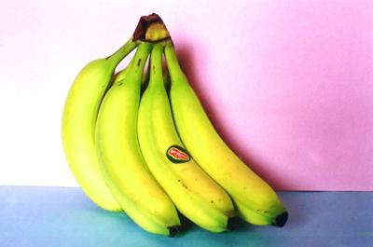
Rf-test3: imagenet DATA_URL = 'http://download.tensorflow.org/models/image/imagenet/inception-2015-12-05.tgz'
imagenet
D:\tensorflow\models-master\tutorials\image\imagenet
run_inference_on_image('banana.jpg')
: 0000:02:00.0, compute capability: 6.1)
2020-02-21 20:06:22.555089: I tensorflow/stream_executor/dso_loader.cc:152]
successfully opened CUDA library cublas64_100.dll locally
banana (score = 0.99933)
orange (score = 0.00003)
zucchini, courgette (score = 0.00002)
pineapple, ananas (score = 0.00001)
shopping basket (score = 0.00001)
(tf-gpu) PS D:\tensorflow\models-master\tutorials\image\imagenet>

Slide 102
Tf-test4: cifar10 object recognition of 10 classes
D:\tensorflow\models-master\tutorials\image\cifar10??>

Slide 103

Another connection example for CNN
Some systems can use different arrangements for connecting 2 neighboring layers
http://www.wildml.com/2015/11/understanding-convolutional-neural-networks-for-nlp/

Slide 104

Relu (Rectified Linear Unit) layer (To replace Sigmoid or tanh function)
Some CNN has a Relu layer
If f(x) is the layer input , Relu[f(x)]=max(f(x),0)
It replaces all negative pixel values in the feature map by zero.
It can be used to replace Sigmoid or tanh.
The performance is shown to be better Sigmoid or tanh.
https://ujjwalkarn.me/2016/08/11/intuitive-explanation-convnets/

Slide 105





Answer :Exercises on CNN Exercise 1: Convolution (conv) layer How to find the curve feature
Exercise on convolution (implemented by correlation, see appendix).
Find Y=correlation( A,C). If Y>5000, image A has feature C
Answer:_________?=(20*30)+(50*30)+(50*30)=3600 (a bit small)
What does the result of convolution( A,C) represent?
Answer: That means the image in window A has no feature like C.
Image A=
Kernel feature C (empty cell = 0)
 | 30
 |  | 30
 |  |  | 30
 |  | 30
 |  | 30
 |  |  | 30
 |  |  |  | 30
*

Slide 106
Answer2: and Demo (click image to see demo)
http://deeplearning.stanford.edu/wiki/images/6/6c/Convolution_schematic.gif , https://link.springer.com/content/pdf/10.1007%2F978-3-642-25191-7.pdf
1 | 0 | 1
0 | 1 | 0
1 | 0 | 1
This is a 3x3 mask for illustration purpose,
but noted that the above application uses a 5x5 mask.
Input image
A different kernel generates a different feature map
A feature map
X
Convolution mask
Y
Exercise 2: (a) Find X,Y. Answer=____4 , Y=______3
(b) Find X again if the correlation mask is [0 2 0;
2 0 2;
0 2 0].
Answer:X_{new}=2*1+2*1+2*1=6

Slide 107
Answer 3: A small example of how the feature map is calculated
output feature map 5x5
Input image 7x7
Kernel 3x3
correlation
with
For each dimension, N=image_width, m=kernel (mask) width, s=step size, output_feature_map_width={ [(N-m)/s]+1}
If the step size of the correlation is 1 pixel (horizontally and vertically), explain why the above output feature map is 5x5.
If input is 32x32, mask is 5x5, what is the size of the output feature map if step size is 1? Answer: _______ { [(N-m)/s]+1}=28x28, because for each dimension, N=image_width, m=kernel (mask) width, s=step size, output_feature_map_width={ [(N-m)/s]+1}
If input is 28x28, what is the size of the subsample layer? Answer:________14x14
If input is 14x14, kernel=5x5, what is the size of the output feature map if step size is 1? Answer:__________ 10x10
In question(a), if the step size of the convolution is 2 pixels, What is the size of he output feature map. Answer:____________? { [(N-m)/s]+1}={ [(7-3)/2] +1) =3, so 3x3 3x3

